Slide 1
Cloud Computing
28 hours course

Slide 2
TABLE OF CONTENTS
Introduction
The Information System of a Company
The Cloud
The Advantage of the Cloud (Cloud vs On-Premises)
Overview of Google Cloud Platform
Introduction to Operating Systems
Linux vs Windows
Linux / Windows Commands
Virtualization
Evolution of Application Deployment
Demo: Deployment of an ML Application
Deployment on a Local Server (or VM) vs on GCP
This step includes the installation and configuration of a VM from scratch
Deployment in a Container Locally vs on a Managed Service on GCP
Deployment of a Google Cloud Function
Main GCP Services
AI Services on GCP

Slide 3
INTRODUCTION

Slide 4
INTRODUCTION
Roundtable:
Name, internship, missions and feedback
Your knowledge in IT in general (cloud, infrastructure, etc.)
Presentation of an enterprise's IT infrastructure: on-premises vs. Cloud
How to deploy a machine learning application
Manipulation of cloud resources to better illustrate different concepts
Application of acquired knowledge
The more we interact, the more we learn, so take advantage of it!

Slide 5
In your opinion, what is information system ? What is cloud computing ?

Slide 6
THE INFORMATION SYSTEM OF A COMPANY

Slide 7
THE INFORMATION SYSTEM OF A COMPANY
The information system is an organized set of hardware, software, human, and procedural resources used to collect, store, process, and distribute information within a company.
It ensures the management and circulation of data necessary for the operation and decision-making within the company.
Well-designed architecture ensures the efficiency, security, and flexibility of the system, aligned with the company's objectives and needs.

Slide 8
L’ARCHITECTURE DU SI
Presentation of Main Components:Servers:
Computer hardware where applications and data are hosted. They handle the processing of various requests.
Network:
Infrastructure enabling communication and data transmission between different system components.
Databases:
Data management systems allowing storage, security, and access to information.
Application Software:
Programs used to perform specific tasks within the company. This addresses business needs.
These components are physically located in a data center managed by the company or in a portion of a data center leased by the company.

Slide 9
Cloud Computing

Slide 10
CLOUD COMPUTING
Definition of Cloud Computing:
A model for delivering computing resources over the Internet, allowing access to services on demand.
Offers the same components of the IS infrastructure presented in the previous slides.
Explanation of How it Works:
Data and applications are hosted on remote servers located in data centers managed by Cloud service providers.
Users access resources on demand via the Internet, based on their needs.
Key Advantages:
Scalability:
Quickly adjust resources according to demand. For example, if there are too many requests on a website, launch multiple instances of the same virtual machine hosting it.
Flexibility:
Choice of services and features according to the specific needs of the company.
Cost Reduction:
Pay-as-you-go, avoiding significant initial investments. Start with basic usage and scale up as needed.

Slide 11
CLOUD COMPUTING
Presentation of Major Cloud Service Providers:
Amazon Web Services (AWS):
Offers a wide range of cloud services.
Microsoft Azure:
Strong integration with Microsoft products.
Google Cloud Platform (GCP):
Focuses on artificial intelligence and data analytics.
Brief Overview of Their Offerings and Market Share:
All these providers offer virtually the same services.
Each provider offers a diverse range of services tailored to the needs of businesses of all sizes.

Slide 12
CLOUD COMPUTING
Highlighting French Cloud Providers:
OVHcloud:
European leader, offering a wide range of Cloud services.
Scaleway:
Provides Cloud solutions tailored to startups and SMEs.
Cloudwatt:
Focused on meeting the needs of public and private sectors in France.
Specific Advantages of Choosing a Local Provider:
Regulatory Compliance:
Compliance with French laws and regulations regarding data protection.
Technical Support in French:
Customer support and assistance in the local language, facilitating communication and issue resolution.

Slide 13
Cloud vs on-prem

Slide 14
Cloud vs on-prem
Explanation of Two Models:
Cloud :
Computing resources are hosted and managed by external providers.
On-Premises Infrastructure:
Computing resources are hosted and managed internally by the company.
Contrast Between Costs, Management, Scalability, and Flexibility:
Costs:
Cloud: Pay-as-you-go model, no upfront investment.
On-Premises: Upfront investment in hardware, software, and maintenance costs.
Management:
Cloud: Provider manages infrastructure, updates, and maintenance.
On-Premises: Company manages infrastructure, updates, and maintenance.
Scalability:
Cloud: Easily scale resources up or down based on demand.
On-Premises: Limited scalability, requires investment in additional hardware for expansion.
Flexibility:
Cloud: Offers flexibility to adapt resources to changing needs quickly.
On-Premises: Less flexible, requires time and resources to implement changes.

Slide 15
THE ADVANTAGE OF THE CLOUD
Here's the content formatted as bullet points for your PowerPoint presentation:
Reduction of Operational and Initial Investment Costs:
Elimination of costs associated with purchasing, maintaining, and upgrading infrastructure.
Pay only for what is used.
No need to manage a data center and physical servers (electricity, cooling, updates, etc.).
Immediate Scalability and Resource Elasticity:
Quickly adjust capacities based on fluctuating business needs.
Example of a web application.
Access to Cutting-Edge Technologies without Internal Expertise Requirement:
Cloud providers offer a wide range of ready-to-use services and solutions.
For example, a data scientist can typically deploy ML models without needing another IT team.
Improvement of Availability, Security, and Resilience:
Cloud providers generally ensure high levels of service and advanced security measures to protect data and applications.

Slide 16
Google Cloud platform

Slide 17
Google cloud platform
Introduction to Google Cloud Platform (GCP):
GCP is a suite of cloud services offered by Google, providing a comprehensive range of solutions for development, deployment, and management of applications on the cloud.
Key GCP Services:
Google Compute Engine:
Infrastructure as a Service (IaaS) allowing deployment of virtual machines.
Google Cloud Storage:
Highly scalable and durable object storage service.
Google Kubernetes Engine (GKE):
Fully managed Kubernetes container management service.
Google Cloud Functions:
Serverless service for executing code in response to events.
Google Cloud Run:
Fully managed container platform for deploying and managing containers.

Slide 18
Google cloud platform
Advantages of GCP:
Scalability:
GCP services are designed to adapt to the evolving needs of businesses, allowing for starting small and growing as needed.
Reliability:
GCP ensures high availability levels through its global network of data centers.
Security:
Google heavily invests in securing its infrastructure, providing a highly secure Cloud environment.
Innovation:
GCP offers cutting-edge services in areas such as artificial intelligence, machine learning, and data analytics.
Use Cases of GCP:
Web and mobile application development.
Data analysis and real-time processing.
Machine learning and artificial intelligence.
Infrastructure management and DevOps.

Slide 19
Google cloud platform
Conclusion:
Google Cloud Platform provides a comprehensive range of cloud services allowing businesses to develop, deploy, and manage their applications efficiently and at scale.
Its feature-rich ecosystem and commitment to innovation make it a popular choice for many businesses seeking cloud solutions.

Slide 20
Google cloud platform
Regions:
Regions represent specific geographical areas where Google Cloud resources are located.
Each region consists of at least two zones.
Google Cloud offers a wide range of regions to meet data localization and latency needs.
Zones:
Zones are distinct locations within a region.
Each zone is designed to be isolated from failures in other zones.
Resources deployed in different zones offer high availability and increased resilience.
Example:
Region: europe-west1 (Belgium)
Zone: europe-west1-b
Zone: europe-west1-c
Zone: europe-west1-d

Slide 21
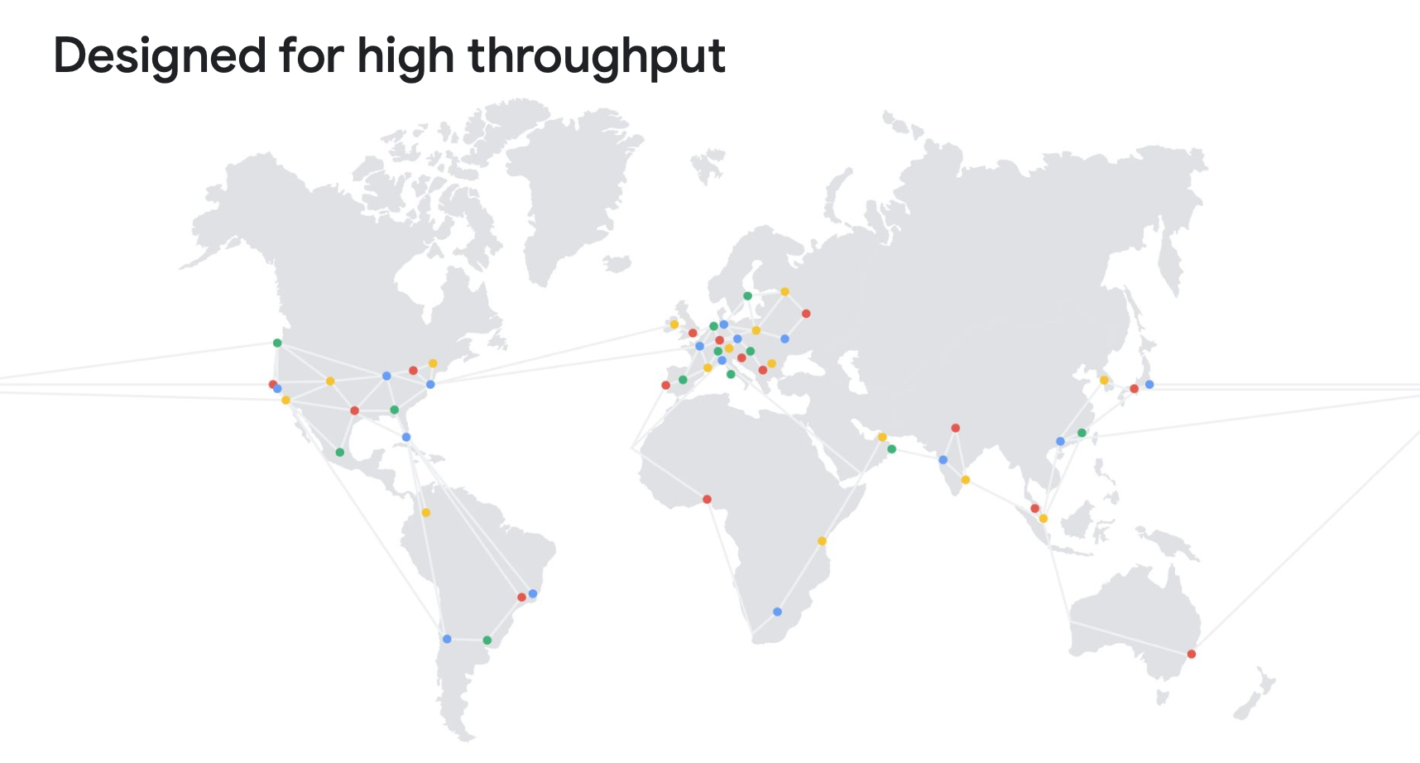
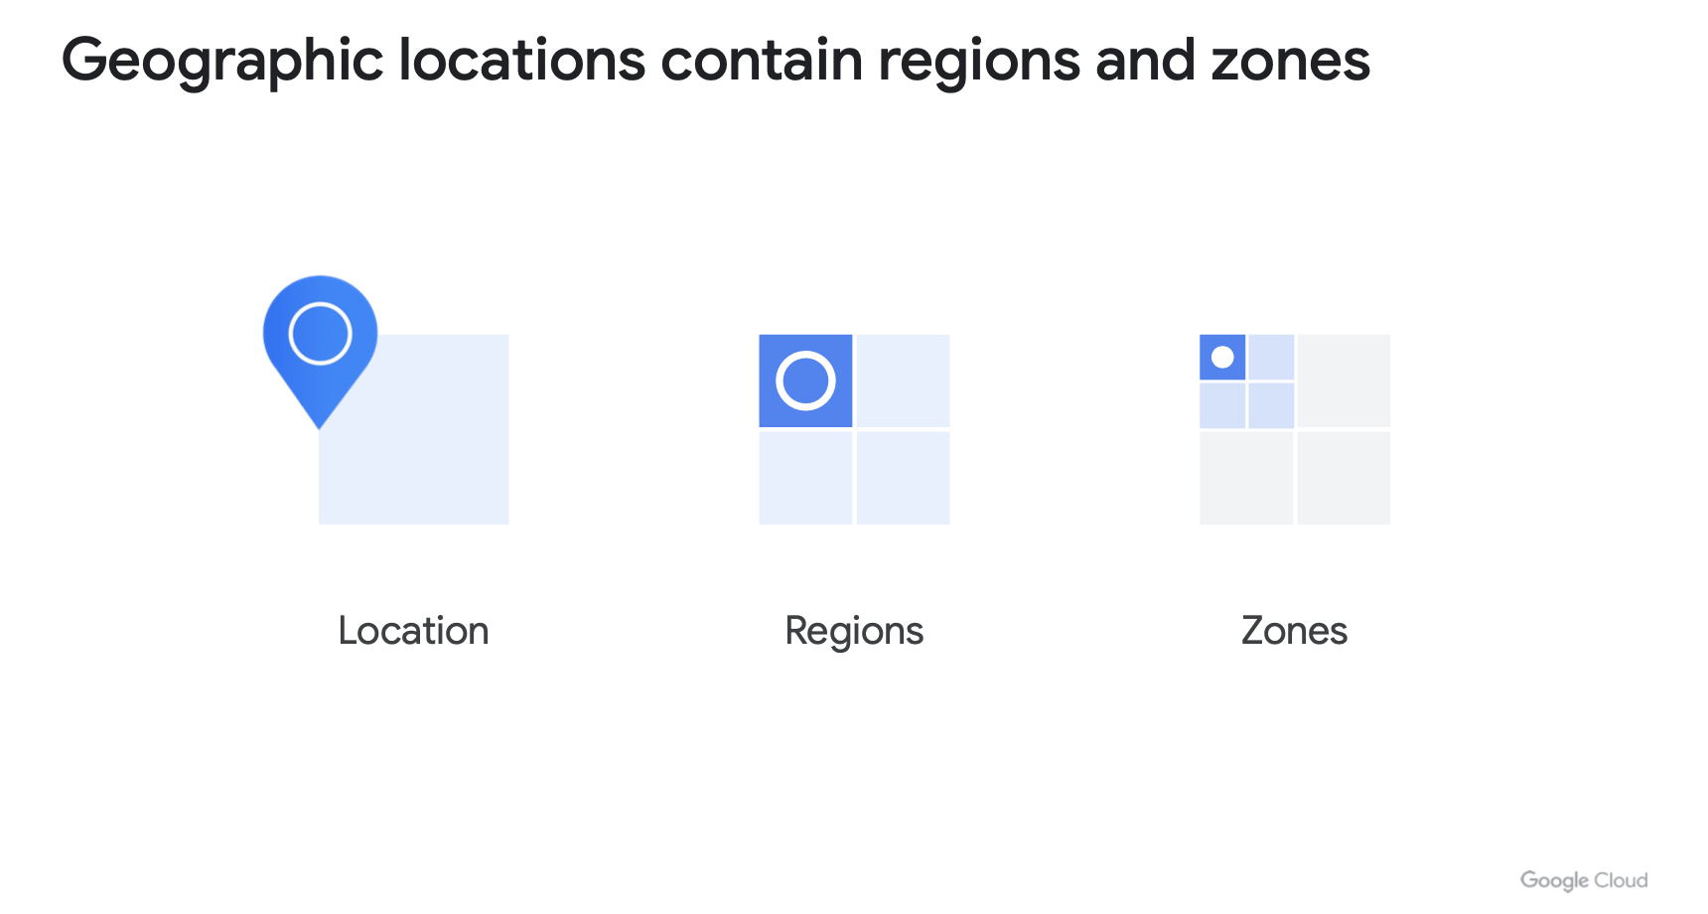
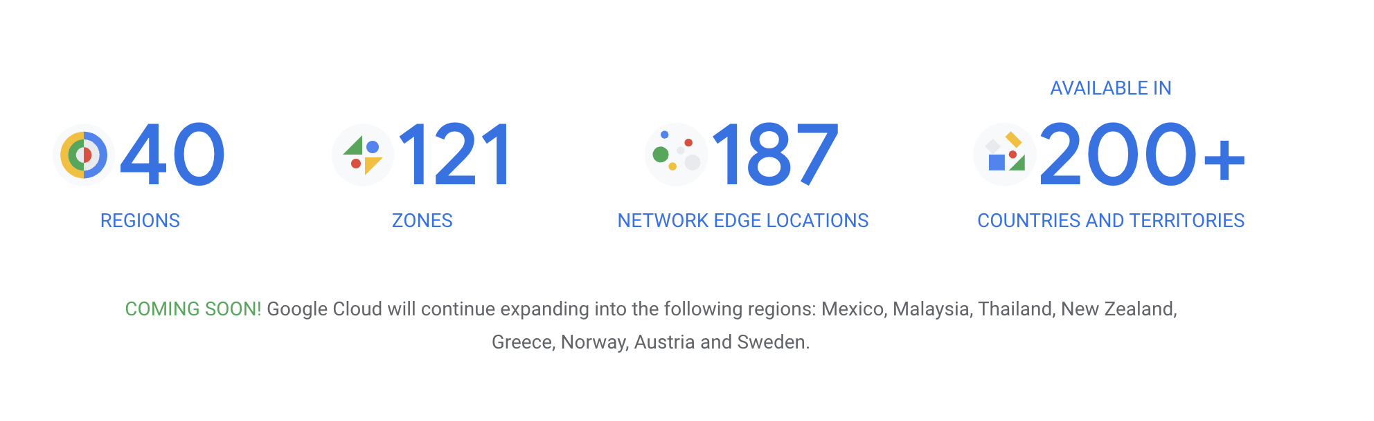
Google cloud platform

Slide 22
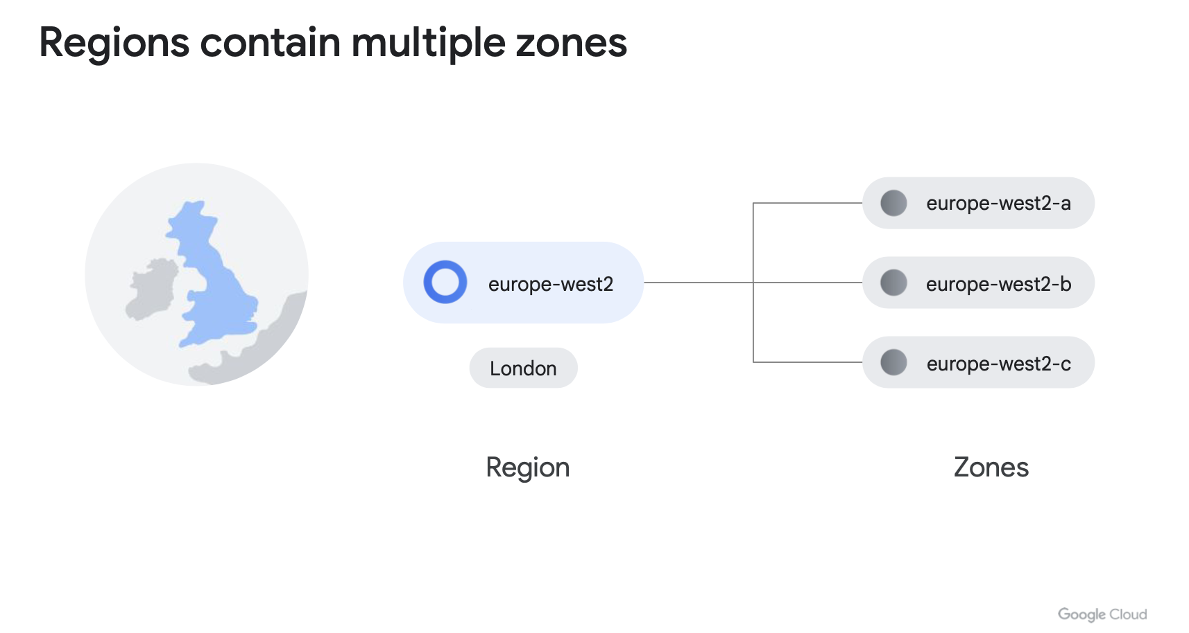
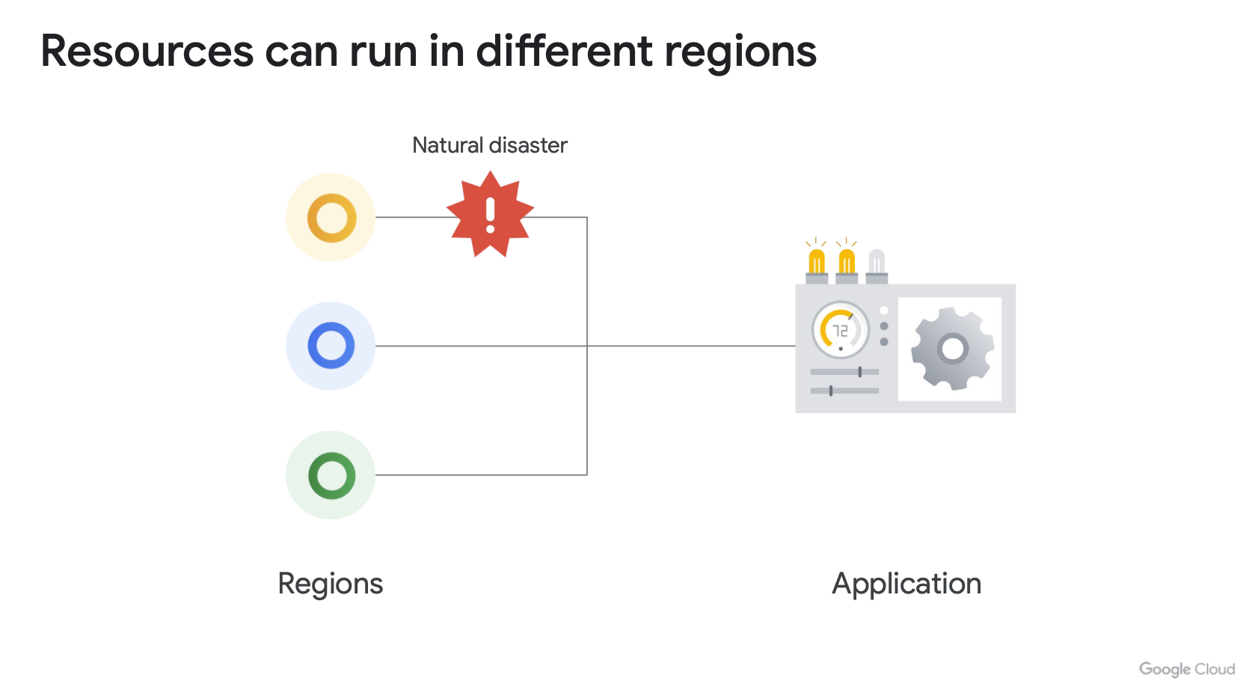
Google cloud platform

Slide 23
OPERATING SYSTEMS

Slide 24
OPERATING SYSTEMS
Introduction to Operating Systems:
Operating systems are software that manage hardware resources and enable the execution of other programs on a computer.
Windows:
Developed by Microsoft, widely used in office and enterprise environments.
Linux (Unix):
Family of open-source operating systems based on Unix, used notably in server environments and in the Cloud.

Slide 25
Windows vs linux
User Interface:
Windows: User-friendly Graphical User Interface (GUI) with File Explorer.
Linux: Default Command Line Interface (CLI), but graphical desktop environments are also available.
File Management:
Windows: Uses drives (C:, D:, etc.) to organize files.
Linux: Single hierarchical file system (root /) with a standard directory structure.
Security:
Linux: Known for its robust security, thanks to its granular permissions and user-based security model.
Windows: Often targeted by malware due to its widespread popularity, but also has advanced security measures.

Slide 26
SOME WINDOWS COMMANDS
Command Prompt (CMD) Commands:dir:
Displays a list of files and directories in the current directory.
cd: Changes the active directory.
mkdir: Creates a new directory.
copy: Copies files.
del: Deletes files.
ipconfig: Displays the system's IP configuration.

Slide 27
Some linux commands
Shell (Bash) Commands:
ls: Displays a list of files and directories in the current directory.
cd: Changes the active directory.
mkdir: Creates a new directory.
cp: Copies files.
rm: Deletes files.
ifconfig: Displays the system's network configuration.
Some Additional Linux-Specific Commands:
grep: Searches for patterns in files.
chmod: Modifies permissions of files and directories.
sudo: Executes a command with administrative privileges.

Slide 28
Why linux commands are important ?
In the Cloud:
Knowledge of basic commands for navigating, managing, and automating tasks is crucial.
Usage in Cloud Environments:
Administration of virtual instances, deployment, and management of Cloud services can often be performed via command line interfaces.
Examples of Applications:
Automation of ETL (Extract, Transform, Load) processes, configuration management, resource monitoring, etc.
Continuous Learning:
It is recommended to invest time in learning and practicing commands to become more efficient and skilled in the cloud.

Slide 29
APPLICATION DEPLOYMENT

Slide 30
Evolution of application deployment
Evolution of Technologies and Practices:
The evolution of technologies and practices has significantly influenced how applications, including websites, are deployed and managed.
Traditional Deployment:
In the pre-cloud era, deploying a website often involved managing a physical server or a dedicated server in a data center.
Manual and Complex Process:
Hardware configuration, software installation, management of updates and patches, etc.
Limitations in Scalability and Flexibility:
Resources were often underutilized, and adjusting capacities was difficult.

Slide 31
Evolution of application deployment
The Emergence of Virtualization and Cloud Computing:
Virtualization has enabled the creation of virtual machines (VMs), offering better utilization of hardware resources.
Cloud Computing has introduced Infrastructure as a Service (IaaS), Platform as a Service (PaaS), and Software as a Service (SaaS) offerings, providing increased scalability and agility.
Deployment on virtual servers or Cloud services allows simplified management, on-demand scalability, and cost reduction.

Slide 32
Evolution of application deployment
The Era of Containerization and Orchestration:
Containerization with tools like Docker has introduced lightweight and portable environments for running applications.
Kubernetes has become the de facto leader in container orchestration, enabling automated deployment, scaling, and management of containerized applications.
Simplification of deployment, reduction of dependencies and conflicts, and acceleration of development cycles through automation.

Slide 33
Evolution of application deployment
The Emergence of Serverless Computing:
Serverless Computing, also known as Functions-as-a-Service (FaaS), allows running code without managing the underlying infrastructure.
Cloud providers offer Serverless platforms such as AWS Lambda, Google Cloud Functions, and Azure Functions.
Rapid deployment, automatic scalability, pay-per-use billing, ideal for on-demand workloads and event-driven applications.
In practice, it's a Python or JS function, for example, that applies processing to something. This processing is triggered by a trigger (an event: file upload, API call, etc.).

Slide 34
Evolution of application deployment
Conclusion :
The evolution of application deployment, from traditional methods to modern Cloud Computing and Serverless technologies, has significantly transformed how applications are designed, deployed, and managed.
Companies now have access to sophisticated tools and platforms to meet the needs of their applications, ensuring maximum scalability, agility, and operational efficiency.

Slide 35
LA VIRTUALISATION

Slide 36
VIRTUALISATION
Introduction to Virtualization:
Virtualization is a technology that allows creating multiple isolated virtual environments on the same physical hardware.
History of Virtualization:
Initial development in the 1960s with the first virtualization systems for mainframe computers.
Increasing adoption in the 2000s with the popularization of x86 virtualization technologies.
Evolution towards container virtualization in the 2010s with the emergence of Docker and Kubernetes.

Slide 37
VIRTUALISATION – virtual machines
Definition of Virtual Machines:
Virtual Machines are virtual computer environments that function as standalone operating systems on a single physical hardware.
Use Cases of Virtual Machines:
Isolation of Applications:
Each VM can run applications and services in isolation, ensuring security and stability.
Development and Testing:
Creation of independent development and test environments for applications.
Server Consolidation:
Running multiple workloads on a single physical server for efficient resource utilization.

Slide 38
VIRTUALISATION – virtual machines
Hypervisor (or Virtual Machine Monitor):
Software responsible for managing VMs and allocating physical resources.
Virtual Machines:
Each VM contains a complete operating system, including the kernel, drivers, and applications.
The hypervisor manages physical resources and allows multiple VMs to run on a single physical server.

Slide 39
VIRTUALISATION - containers
Definition of Docker Containers:
Docker containers are lightweight and portable instances of software applications, bundling everything they need to run, including code, libraries, and dependencies.
Use Cases of Docker Containers:
Application Deployment:
Docker containers facilitate the deployment of applications in any environment, whether it's a local server, a public cloud, or a hybrid cloud.
Consistent Development Environments:
Containers ensure that development environments are consistent across teams, thereby avoiding compatibility issues.
Microservices:
Containers are often used in a microservices architecture to encapsulate each service in an isolated and scalable manner.

Slide 40
VIRTUALISATION - containers
Docker Engine:
Containerization platform for creating, managing, and running containers.
Main Components:
Docker Daemon, Docker Client, Docker Registry.
Containers:
Containers share the same kernel as the host operating system.
They only include the libraries and dependencies required for the application, making them lightweight and portable.

Slide 41
VIRTUALISATION – KUBERNETES
Definition of Kubernetes:
Kubernetes is an open-source container orchestration management system designed to automate the deployment, scaling, and management of containerized applications.
Use Cases of Kubernetes:
Container Orchestration:
Kubernetes simplifies the management of a large number of containers by automating tasks such as deployment, scaling, and resource management.
High Availability:
Kubernetes ensures application availability and resilience by automatically redeploying containers in case of failure.
Multi-Cloud Deployments:
Kubernetes is used to orchestrate application deployments across multiple cloud environments, enabling workload portability.

Slide 42
VIRTUALISATION – KUBERNETES
Kubernetes:
Open-source container orchestration system for automating the deployment, scaling, and management of containerized applications.
Architecture of Kubernetes:
Master:
Main components: API Server, Scheduler, Controller Manager, and etcd.
Nodes:
Main components: Kubelet, Kube-proxy, and Container Runtime.
Pods:
Basic unit in Kubernetes, containing one or more containers.
Services:
Abstraction that defines a set of pods and an access policy to these pods.

Slide 43
VMs vs containers
Virtual Machines (VMs):
Isolation:
Each VM contains a complete operating system, offering full isolation of hardware resources.
Size:
VMs are larger due to the inclusion of a complete operating system and necessary applications.
Startup Time:
VMs take longer to start as they need to load a complete operating system.
Resource Usage:
VMs consume more resources due to the overhead of the operating system.
Containers:
Isolation:
Containers share the same kernel as the host operating system, offering lightweight isolation.
Size:
Containers are lighter as they share the same kernel as the host operating system and only include necessary libraries and dependencies for the application.
Startup Time:
Containers start quickly as they do not need to load a complete operating system.
Resource Usage:
Containers consume fewer resources as they avoid the overhead of the operating system.

Slide 44
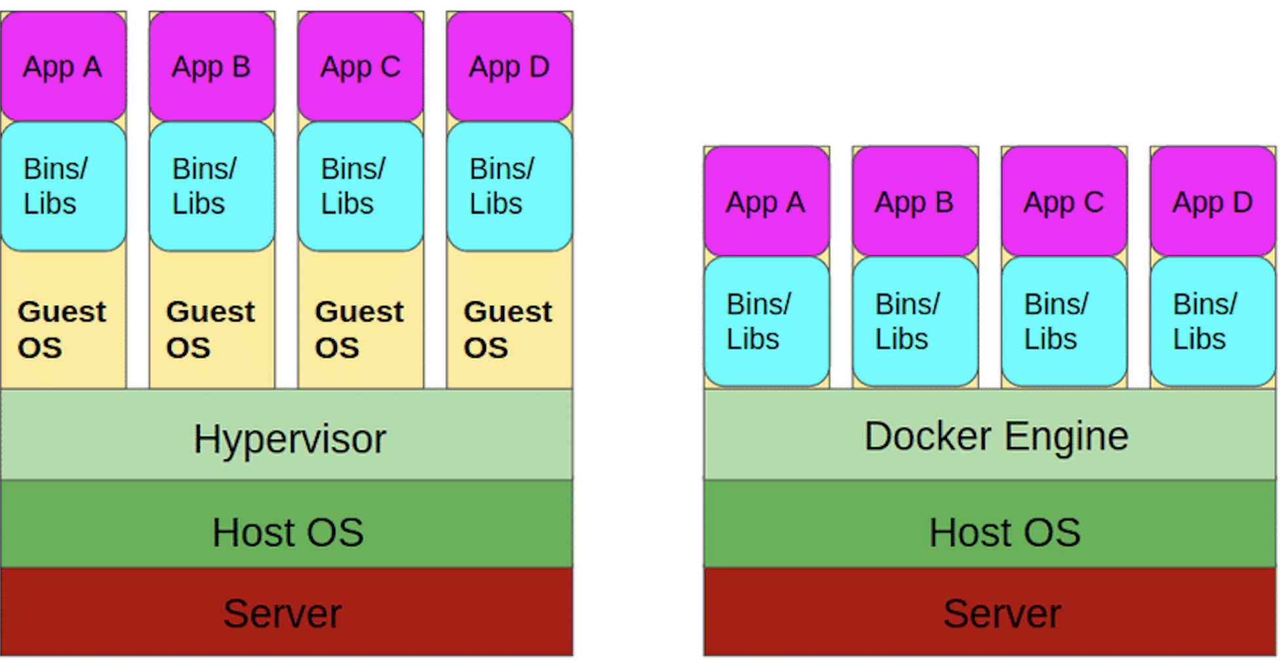
VMs vs containers

Slide 45
VIRTUALISATION - CONCLUSION
Virtual Machines (VMs):
Offer complete isolation but are heavier and consume more resources.
Containers:
Offer lightweight isolation, are lightweight, and start quickly.
Kubernetes:
Simplifies the deployment and management of containerized applications at scale by automating orchestration tasks.
Choice Depends on Specific Business Needs:
Depends on the specific needs of the business in terms of isolation, performance, and resource management.

Slide 46
DEMO : Deploying a machine learning app

Slide 47
ML APP DEPLOYMENT
In this section, we will explore how deploying a developed Streamlit application can be achieved on various platforms, from a local VM to managed cloud services like Google Cloud Run and Google Cloud Functions.

Slide 48
ML APP DEPLOYMENT
Deployment Steps on a Virtual Machine or Local Server:
Download and install virtualization software.
Download a Debian 12 operating system image.
Create a Debian virtual machine in VMware.
Install Python and necessary dependencies.
Transfer the Streamlit application to the virtual machine.
Configure ports and the web server (e.g., Gunicorn).
Launch the application and test its accessibility from a browser.
Update and maintain the virtual machine.
Cost of the VM in the data center: functional and logistical costs.
Deployment Steps on a Virtual Machine on GCP:
Create and configure a Debian virtual machine in Compute Engine.
Install Python and necessary dependencies.
Transfer the Streamlit application to the virtual machine.
Configure ports and the web server (e.g., Gunicorn).
Launch the application and test its accessibility from a browser.
Pay only when the VM is running.

Slide 49
ML APP DEPLOYMENT
Deployment Steps in a Docker Container:
Build the Docker image from a Dockerfile.
Run the Docker container locally for verification.
Publish the image to Docker Hub or a private registry.
Deploy and run the image on any machine with Docker installed.

Slide 50
ML APP DEPLOYMENT
Deployment Steps in Cloud Run:
Prepare the Docker image of the Streamlit application.
Deploy the image to Google Cloud Run via the Cloud console or the command-line interface (CLI).
Configure parameters such as allocated resources and automatic scaling.
An image will be automatically built and pushed to a private registry on GCP.
Access the application via a URL provided by Google Cloud Run.

Slide 51
ML APP DEPLOYMENT
Deployment Steps in a Cloud Function:
Transform the Streamlit application into an asynchronous function managed by Google Cloud Functions.
Deploy the function to Google Cloud Functions via the Cloud console or the CLI.
Configure triggers (e.g., HTTP) to invoke the function.
Test the function invocation using a tool like curl or via a browser.

Slide 52
ML APP DEPLOYMENT
In Conclusion:
Choice depends on the needs, skills, and constraints of each project:
VMs may offer total flexibility while managed cloud services (like Cloud Run) offer simplified management and automatic scaling.
It is essential to explore and experiment with different options to find the one that best suits each use case.

Slide 53
GCP SERVICES THAT YOU MUST KNOW

Slide 54
SECURITY
Custom Design:
Google designs its own server racks and network equipment for its data centers, as well as custom chips, including a hardware security chip.
Boot Security:
Google's server machines use cryptographic signature technologies to ensure they boot with the correct software.
Physical Security:
Google designs and constructs its own data centers with multiple layers of physical protection, limiting access to a small number of employees. Additional security measures are in place for servers hosted in third-party data centers.
Communication Encryption:
Google automatically encrypts all RPC (Remote Procedure Call) traffic between its data centers and deploys cryptographic accelerators to extend encryption to all RPC traffic within its data centers.
User Identity:
Google's identity service goes beyond just username and password by requesting additional information based on risk factors. It also supports secondary authentication factors like U2F (Universal 2nd Factor).
Encryption at Rest:
Most data is stored via storage services with encryption enabled by centrally managed keys, and Google also supports hardware encryption on hard drives and SSDs (Solid State Drives).

Slide 55
SECURITY
Google Front End (GFE):
Google services on the internet use the Google Front End (GFE) for secure connections via TLS (Transport Layer Security). The GFE provides X.509 certificates and public-private keys, as well as protections against DoS (Denial of Service) attacks.
Protection against Denial of Service (DoS) Attacks:
Google can absorb many DoS attacks thanks to its large-scale infrastructure and has multiple protections to mitigate risks on services behind the GFE.
Intrusion Detection:
Rules and artificial intelligence alert security teams to potential incidents. Regular exercises are conducted to enhance detection and response.
Mitigation of Internal Risks:
Google closely monitors the activities of employees with administrative access to the infrastructure to reduce internal risks.
Use of U2F by Employees:
Google employees are required to use U2F-compatible security keys to protect against phishing and other attacks.
Software Development Practices:
Google employs centralized code control and two-party reviews. Developers have access to libraries to avoid security bugs. Additionally, a Vulnerability Rewards Program encourages the discovery and resolution of bugs in Google's infrastructure and applications.

Slide 56
OPEN SOURCE
Concerns about Vendor Lock-In:
Some fear being locked in with a single cloud provider.
Google's Approach:
Google allows customers to switch providers if needed.
Google utilizes open-source licenses to provide alternatives.
Google ensures interoperability at various levels of the technology stack.

Slide 57
pricing
Google Cloud Billing Practices:
Google was the first major cloud provider to offer per-second billing for its Compute Engine service.
Per-second billing is available for Compute Engine, Google Kubernetes Engine, Dataproc, and App Engine flexible environment VMs.
Compute Engine also offers automatically applied sustained use discounts, custom machine types, and an online pricing calculator for cost estimation.
Tools for Cost Management:
Budget definition at the account or project level.
Alerts creation when costs approach budget limits.
Use of reports to monitor expenses.
Implementation of quotas to prevent resource overconsumption.
Types of Quotas:
Rate quotas and allocation quotas applied at the project level and reset at specific intervals.
Projects start with the same quotas, but some can be adjusted by requesting an increase from Google Cloud support.

Slide 58
The hierarchy of GCP resources
The hierarchy of GCP resources comprises four levels: resources, projects, folders, and organization node.
Resources such as virtual machines, Cloud Storage buckets, etc., are at the lowest level.
Projects group resources and are situated at the second level of the hierarchy.
Folders, along with any subfolders, are at the third level and can be used to organize projects.
The organization node, at the highest level, encompasses all projects, folders, and resources.
Policy management is tied to this hierarchy: policies can be defined at the project, folder, and organization node levels.
Some Google Cloud services also allow policy enforcement at the individual resource level.
Policies are inherited downwards: a policy applied to a folder will apply to all projects it contains.

Slide 59
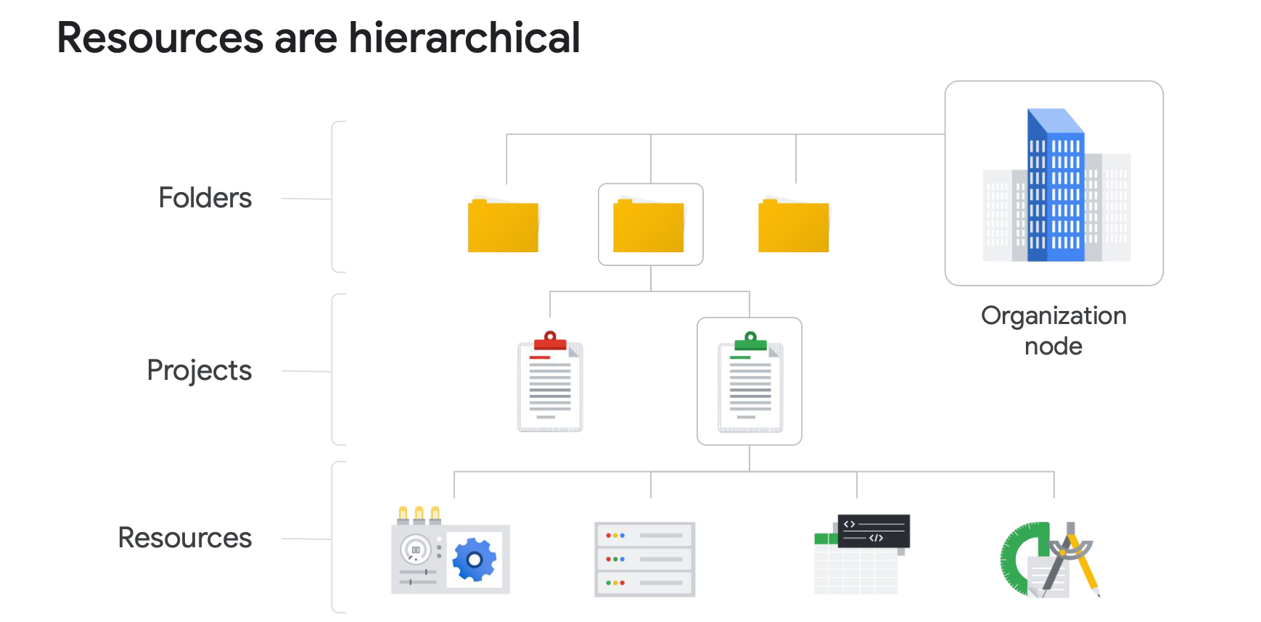
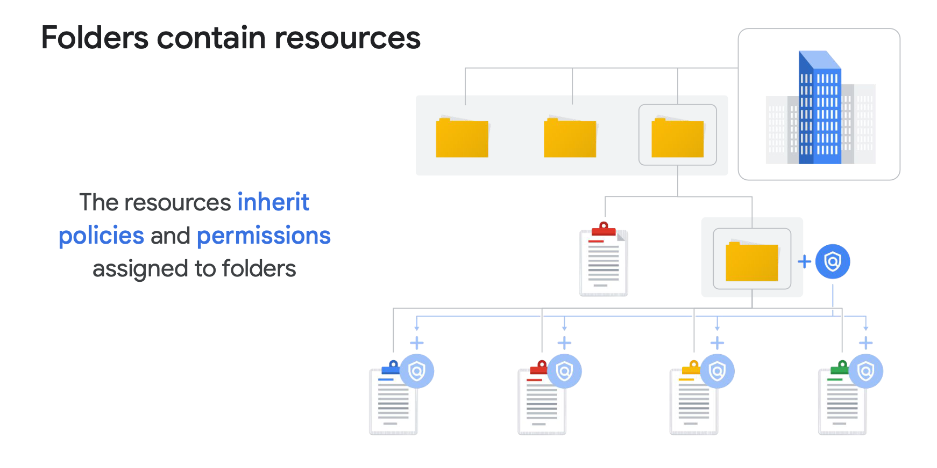
hierarchy

Slide 60
IAM
There are three types of roles in IAM: basic, predefined, and custom.
Basic roles have broad scope and affect all resources within a Google Cloud project when applied. They include owner, editor, viewer, and billing administrator.
Predefined roles are specific to certain Google Cloud services and define a set of predefined actions. For example, Compute Engine offers predefined roles like "instanceAdmin" to manage specific resources.
Custom roles are used to assign more specific permissions following the principle of "least privilege." For example, creating an "instanceOperator" role to allow certain users to manage virtual machines without the ability to reconfigure them.
Service accounts are used to authenticate virtual machines with Google Cloud services. They are associated with an email address and use cryptographic keys to access resources.
The roles assigned to a service account determine the actions that an application running on a virtual machine with that account can perform, such as creating, modifying, or deleting other virtual machines.

Slide 61
IAM
QUIZ :
Choose the correct completion: Services and APIs are enabled on a per-__________ basis.
A: Folder
B: Project
C: Organization
D: Billing account
QUIZ 2
Order these IAM role types from broadest to finest-grained.
A: Custom roles, predefined roles, basic roles
B: Predefined roles, custom roles, basic roles
C: Basic roles, predefined roles, custom roles

Slide 62
VPC
A Virtual Private Cloud (VPC) is a secure and private cloud computing model hosted within a public cloud, such as Google Cloud.
Clients can run code, store data, host websites, and perform all other tasks possible in a regular private cloud on a VPC.
VPCs combine the scalability and convenience of public cloud with the data isolation of private cloud.
VPC networks connect Google Cloud resources to each other and to the internet, including network segmentation, firewall rule usage, and static route creation.
A surprising aspect for many new Google Cloud users: Google VPC networks are global and can have subnetworks, which are segmented parts of the larger network, in any Google Cloud region worldwide.
Subnetworks can cover the zones that make up a region, allowing for global networking, and resources can even be in different zones on the same subnetwork.

Slide 63
COMPUTE ENGINE
Compute Engine allows users to create and run virtual machines on Google's infrastructure without any upfront investments.
Each virtual machine provides full operating system capabilities and can be configured according to CPU, memory, storage, and operating system requirements.
Instances can be created via the Google Cloud Console, CLI, or Compute Engine API.
Compute Engine offers several storage options with unique pricing and performance characteristics.
Custom machine types enable precise selection of instance properties based on requirements.
Persistent disks are recommended for storage needs.
Overall, it is flexible, high-performing, and billed based on actual usage.

Slide 64
GOOGLE CLOUD marketplace
Google Cloud Marketplace is an online platform that allows users to discover, deploy, and manage pre-configured and certified third-party software on Google Cloud Platform (GCP).
Users browse the software catalog, select solutions that meet their needs, and deploy them on their GCP infrastructure with a few clicks.
It offers pre-configured services like databases, web services, etc., based on GCP services like Compute Engine (instead of initiating an empty VM and installing a database, etc.).
The benefits of Google Cloud Marketplace are numerous. Firstly, it provides a wide variety of software and tools, enabling users to quickly find solutions for their specific needs. Additionally, Google Cloud Marketplace ensures compatibility and security of listed software, offering users peace of mind when deploying third-party solutions. Furthermore, Google Cloud Marketplace simplifies the purchasing and billing process, allowing businesses to easily manage their software expenses.
However, there are a few drawbacks to consider. While Google Cloud Marketplace offers great convenience, some software may have additional costs associated with their use, which can increase overall company expenses. Additionally, users must exercise due diligence when selecting software solutions, ensuring they meet their requirements in terms of features, performance, and security.

Slide 65
Load balancer
Load balancer distributes user traffic across multiple instances of an application, reducing the risk of performance issues.
Cloud Load Balancing is a fully distributed and software-defined managed service for all your traffic, offering simplified management without the need to manage or scale virtual machines.
It can be used for various types of traffic, including HTTP(S), TCP, SSL, and UDP.
It provides load balancing across regions with automatic failover between regions in case of failure, while reacting quickly to changes in traffic, instance health, and other related conditions.
No pre-warming is required even in the event of anticipated demand spikes, meaning no support ticket is needed to inform Google of the expected increase in load.

Slide 66
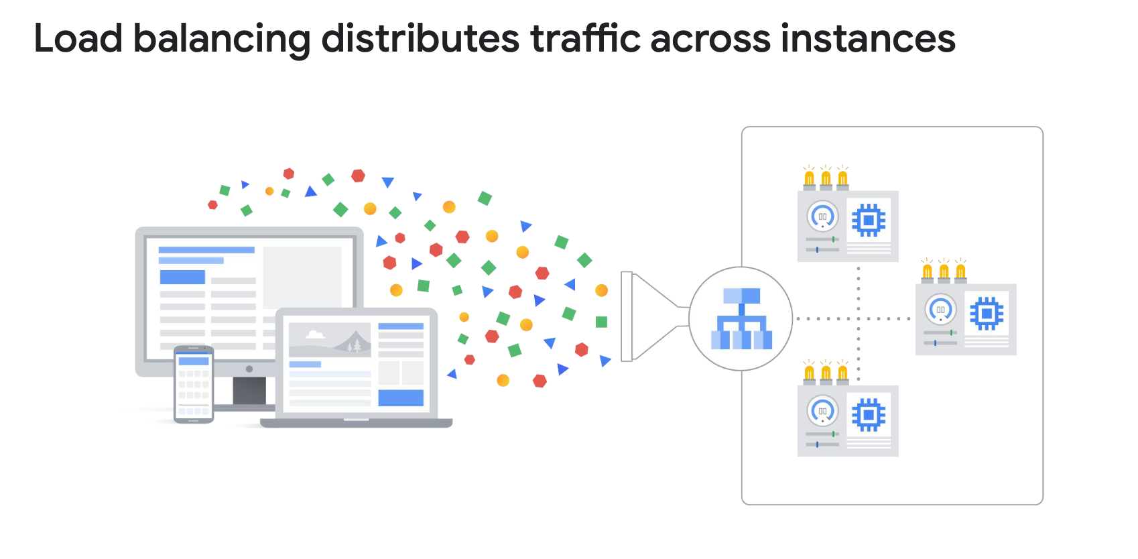
Load balancer

Slide 67
quiz
Google Cloud VPCs, what scope do subnets have?
A: Zonal
B: Regional
VPC subnets can span the zones that make up a region. This is beneficial because your solutions can incorporate fault tolerance without complicating your network topology.
C: Global D: Multi-regional
What is the main reason customers choose Preemptible VMs?
A: To improve performance.
B: To reduce cost.
That's correct! The per-hour price of preemptible and spot VMs incorporates a substantial discount.
C: To use custom machine types
D: To reduce cost on premium operating systems.

Slide 68
Google cloud storage
Object storage is a data storage architecture that manages data as "objects" with metadata and a unique global identifier.
Google Cloud Storage offers fully managed and scalable object storage suitable for various use cases such as data storage for archiving, web content delivery, and distribution of large objects.
Files are organized into "buckets" with unique names and specific geographic locations to minimize latency.
Although it is not a file system, Cloud Storage can be used as one through third-party tools that allow the bucket to be "mounted" as a directory on Linux or MacOS.

Slide 69
Google cloud storage
Cloud Storage offers four main storage classes, and stored data is managed and billed based on the "class" to which they belong.
The first class is Standard Storage, ideal for frequently accessed or "hot" data, as well as data stored for short periods.
The second class is Nearline Storage, intended for infrequently accessed data, such as data backups, long-term multimedia content, or data archiving.
The third class is Coldline Storage, similar to Nearline Storage but designed for even less frequent data access or modifications, at most once every 90 days.
The fourth class is Archive Storage, the least expensive, suitable for data archiving, online backups, and disaster recovery, but with higher access and operation costs and a minimum storage duration of 365 days.

Slide 70
Google cloud sql
Cloud SQL offers fully managed relational databases (MySQL, PostgreSQL, SQL Server) as a service, freeing users from tedious maintenance tasks such as updates and backups.
No software installation or maintenance is required, providing an easy-to-deploy solution.
Scalability capabilities include up to 64 processor cores, over 400 GB of RAM, and 64 TB of storage.
Automatic replication support and managed backups ensure data availability.
Security is enhanced with data encryption and built-in network firewall.
Compute Engine instances can access Cloud SQL instances, facilitating integration into complex environments.
Compatible with various external tools and applications, providing increased flexibility of use.

Slide 71
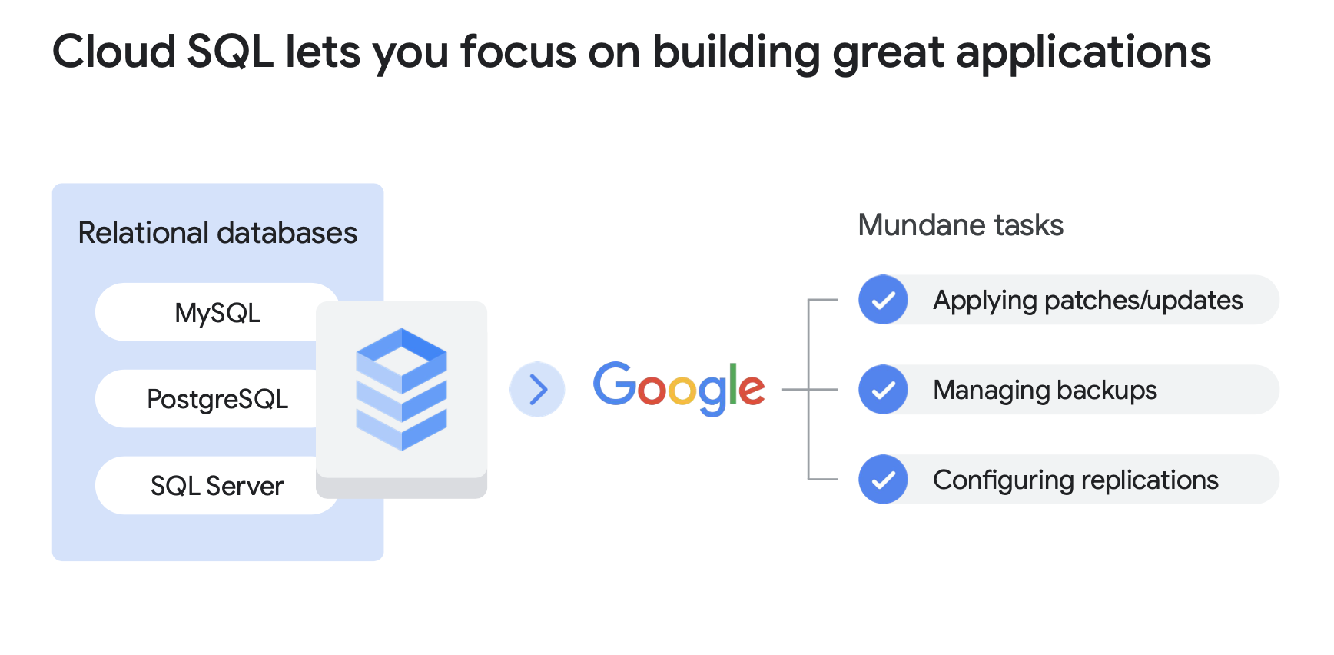
Google cloud sql

Slide 72
Google cloud spanner
Cloud Spanner is a fully managed, horizontally scalable relational database service that supports SQL language and provides strong consistency.
Proven in Google's critical applications and services, Spanner powers Google's $80 billion business.
Cloud Spanner is particularly suitable for applications that require:
A SQL relational database management system with joins and secondary indexes.
Built-in high availability.
Strong global consistency.
A large number of input/output operations per second, ranging up to tens of thousands of reads/writes per second or more.

Slide 73
Google cloud firestore
Firestore is a flexible and scalable cloud NoSQL database for mobile, web, and server development.
Data is organized into documents within collections, allowing efficient queries with filters and sorting options.
Firestore ensures data synchronization across all connected devices, even offline, through data caching.
It leverages Google Cloud's robust infrastructure, providing automatic data replication, strong consistency, and transactional operations.
Billing is based on document reads, writes, deletes, and storage, with a limited number of free operations per day.
It offers a cost-effective or potentially free starting point for developers with daily free quotas.

Slide 74
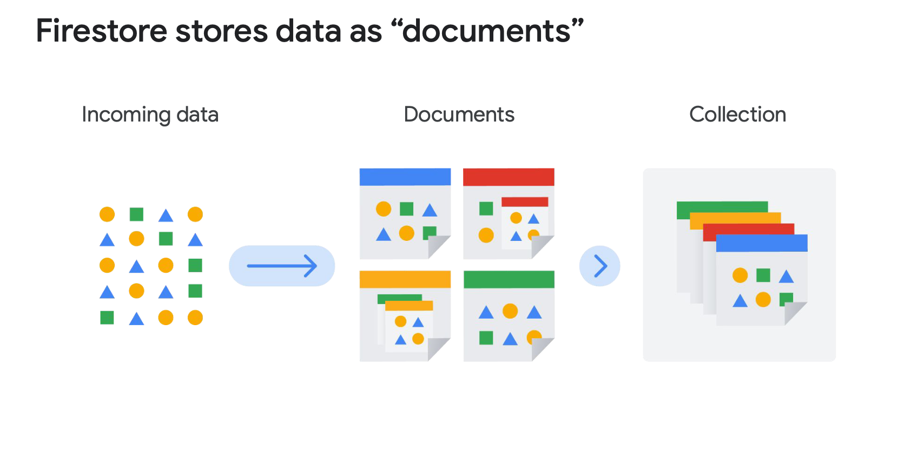
Google cloud firestore

Slide 75
Google cloud bigtable
Cloud Bigtable is Google's NoSQL database service, used by key services such as Search, Analytics, and Gmail.
It offers high performance with low latency, suitable for massive workloads and operational and analytical applications.
Clients choose Bigtable for large data volumes, high throughput, NoSQL data, time-ordered data, or batch and real-time processing.
Bigtable is compatible with other Google Cloud services and third-party clients via APIs, allowing reading and writing data across various layers of stream or batch processing frameworks.
It is used to serve data to applications, dashboards, and data services, as well as for performing calculations and analyses on streaming or batch data.

Slide 76
Google cloud storage options comparaison
Cloud Storage: Storage for immutable objects over 10 MB, up to 5 TB per object, suitable for images or movies.
Cloud SQL / Cloud Spanner: Full SQL support, Cloud SQL up to 64 TB, Cloud Spanner for horizontal scalability.
Firestore: Massive scalability, real-time query results, terabytes of storage capacity, ideal for mobile and web data.
Cloud Bigtable: Storage for a large number of structured objects, petabytes of capacity, recommended for analytical data with many read and write events.

Slide 77
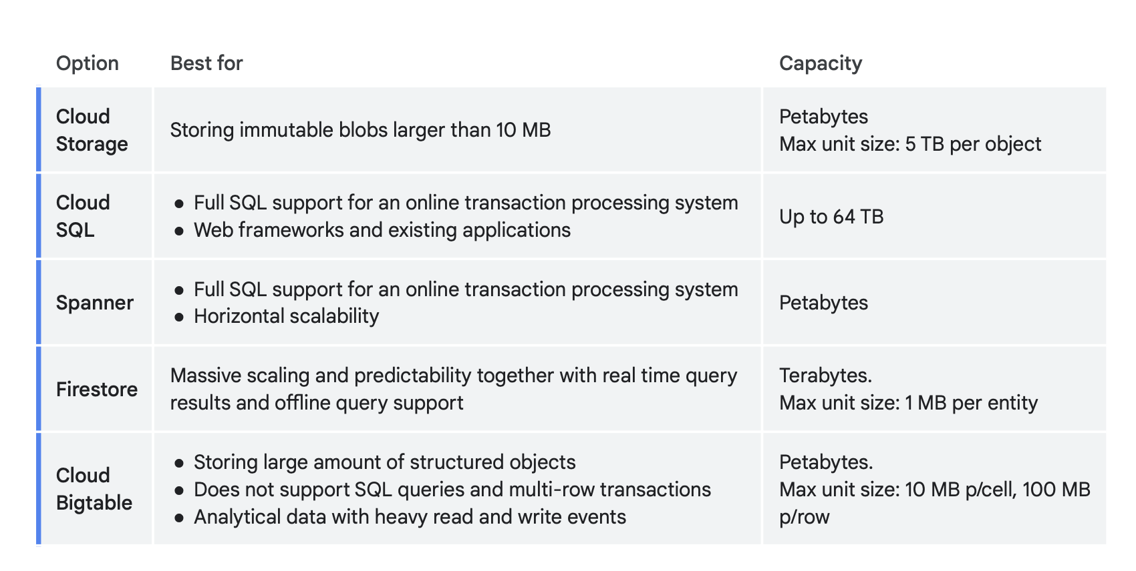
Google cloud storage options comparaison

Slide 78
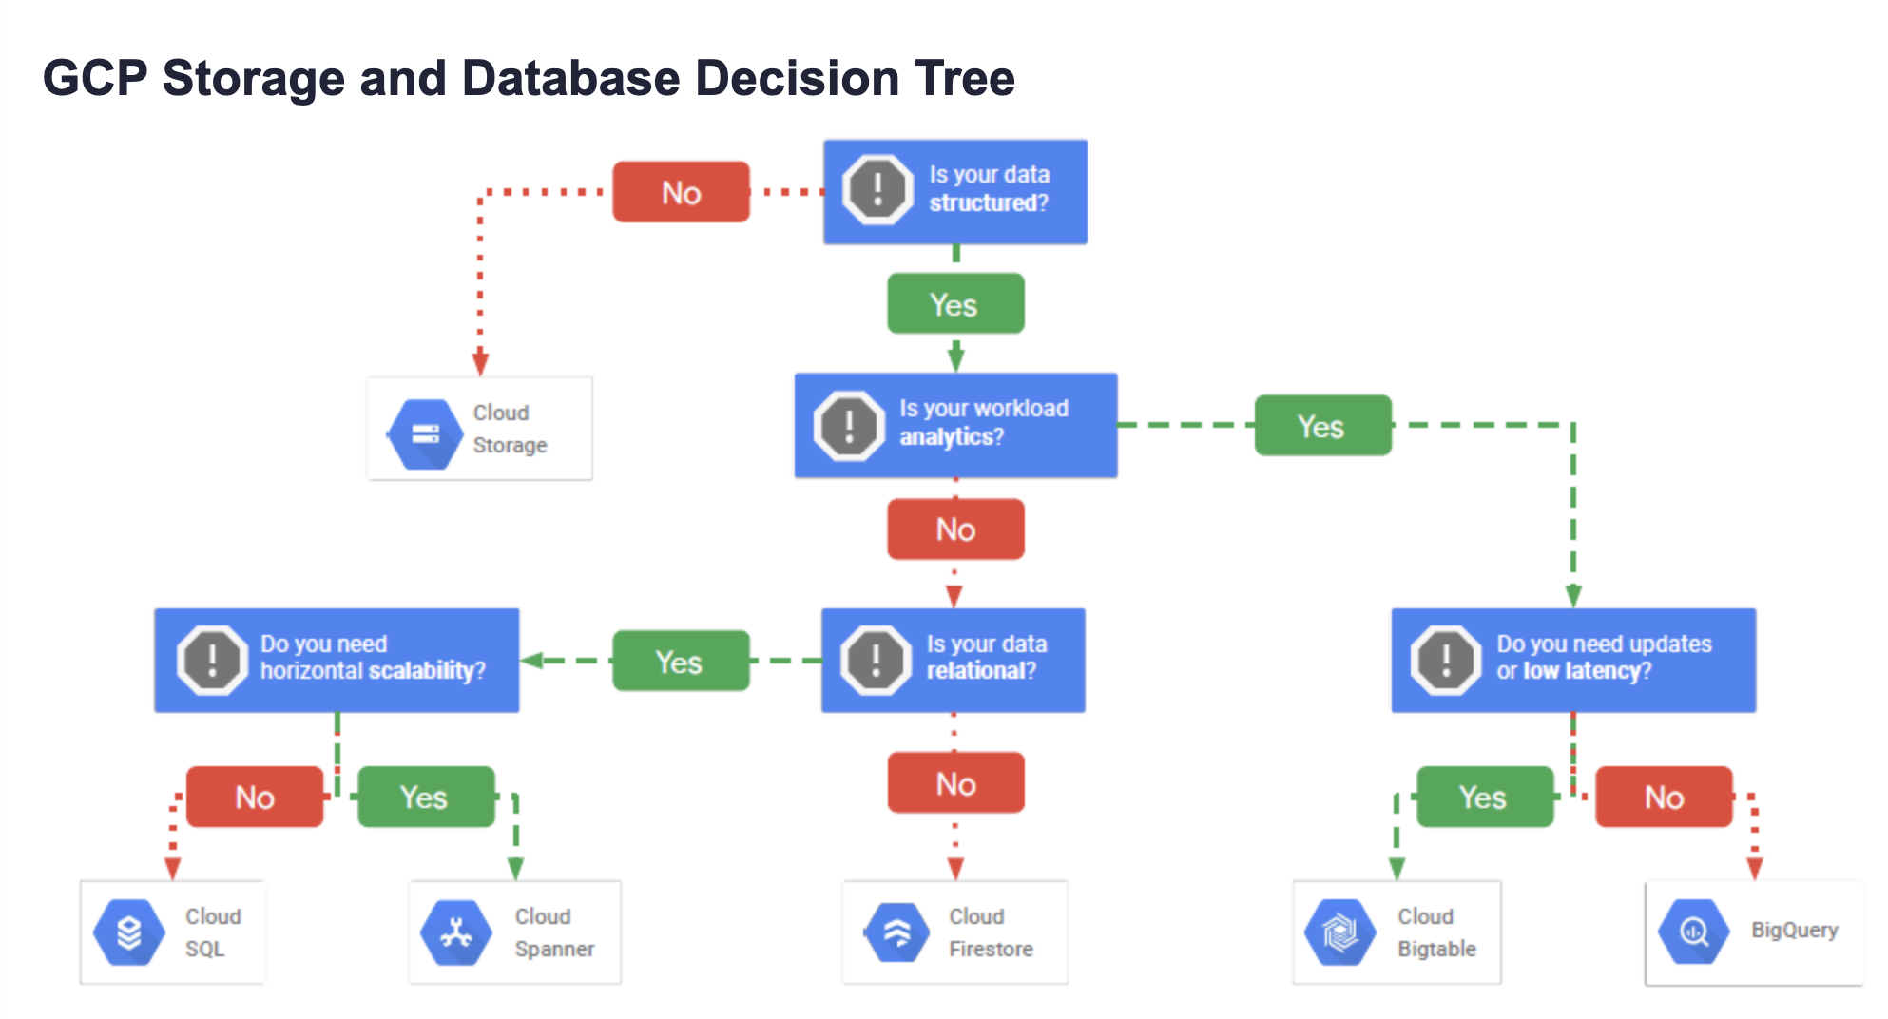
Google cloud storage options comparaison

Slide 79
Google cloud storage options quiz
What is the correct use case for Cloud Storage?
A:Cloud Storage is well suited to providing the root file system of a Linux virtual machine.
B: Cloud Storage is well suited to providing durable and highly available object storage
C: Cloud Storage is well suited to providing data warehousing services
D:Cloud Storage is well suited to providing RDBMS services.
Which SQL database service can scale to higher database sizes?
A: Cloud Spanner.
B: Cloud SQL.
C: Cloud Bigtable
D: Firestore

Slide 80
Google cloud bigquery
BigQuery is a fully managed, highly scalable data warehouse service provided by Google Cloud Platform.
It enables users to analyze vast amounts of data quickly and cost-effectively, without the need for infrastructure setup or maintenance.
BigQuery operates based on columnar storage and distributed query processing.
Users upload their data into BigQuery tables and then execute SQL queries to analyze them.
The benefits of BigQuery are significant:
Exceptional performance, allowing queries to be executed on petabytes of data in just seconds.
Fully managed service, with Google handling infrastructure maintenance, reducing operational burden for users.
Seamless integration with other GCP services such as DataFlow and Pub/Sub, facilitating the construction of comprehensive data pipelines.
However, there are a few drawbacks:
BigQuery's pricing is based on query and storage usage, which can lead to unexpected costs if resources are not used efficiently.
While powerful for data analysis, BigQuery may not be suitable for all use cases, particularly those requiring real-time data updates.

Slide 81
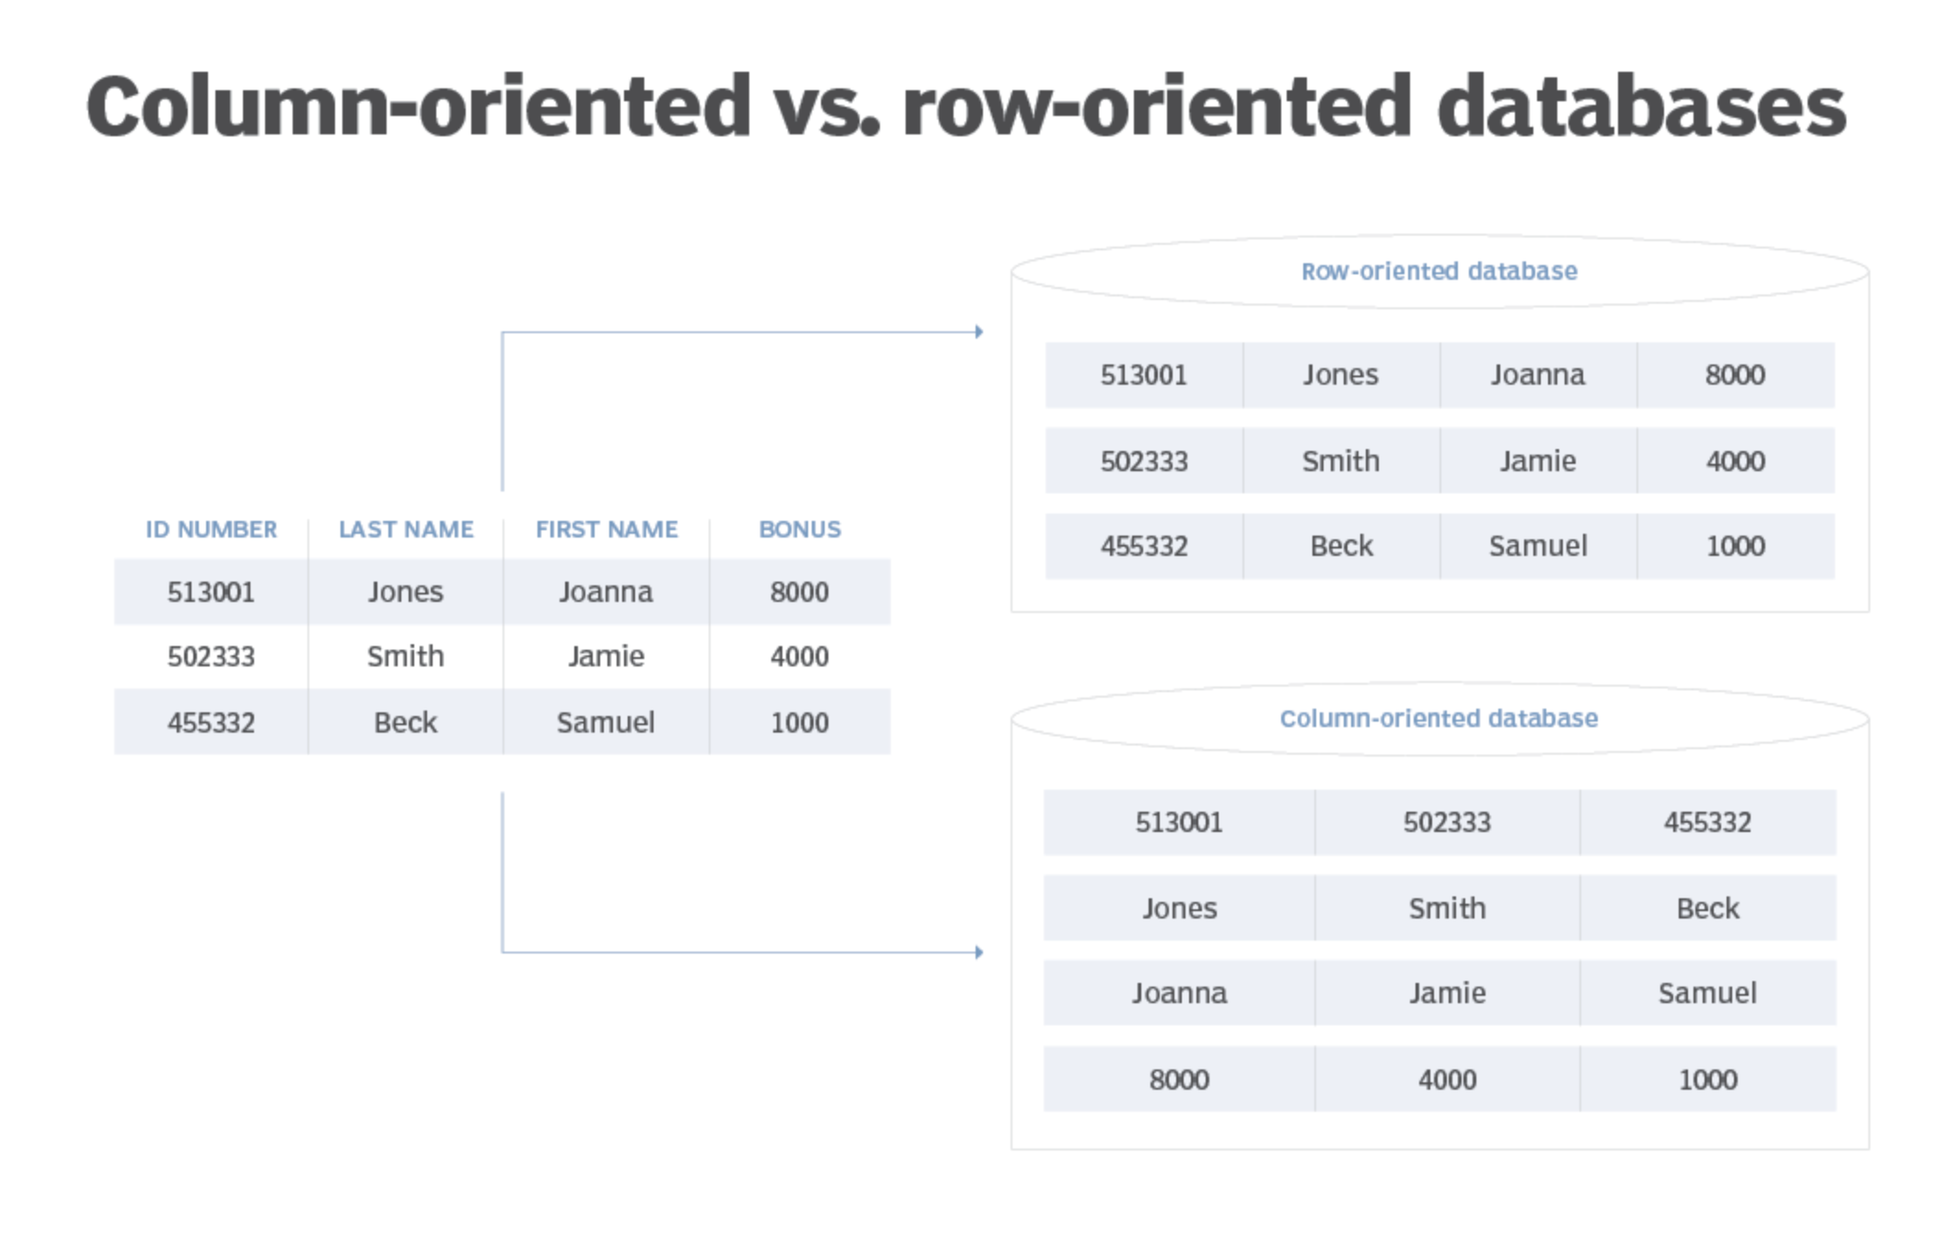
Google cloud bigquery

Slide 82
containers
Containers are virtual boxes surrounding the code and its dependencies, with limited access to the file system and hardware.
They require minimal resources to be created and start quickly, like a simple process.
Containers offer the flexibility of IaaS (Infrastructure as a Service) with the scalability of PaaS (Platform as a Service), making the code portable and enabling deployments without modification on different platforms.
They allow for "code once, run anywhere" capability, facilitating deployment across different infrastructures.
Containers can be easily scaled to meet demand, enabling rapid and efficient application deployment.

Slide 83
kubernetes
Kubernetes is an open-source platform for managing containerized workloads and services.
It allows for the orchestration of numerous containers across multiple hosts, scaling them into microservices, and deploying and rolling back updates.
Kubernetes consists of a set of APIs for deploying containers onto a cluster of nodes.
The nodes in the cluster run the containers, while the control plane manages their deployment and state.
Pods are the basic units in Kubernetes, representing individual processes or entire applications.
Kubernetes enables specifying how applications should interact and manages shared resources among containers.
Kubernetes clusters can be created and managed using Google Kubernetes Engine via the Cloud console or gcloud commands.

Slide 84
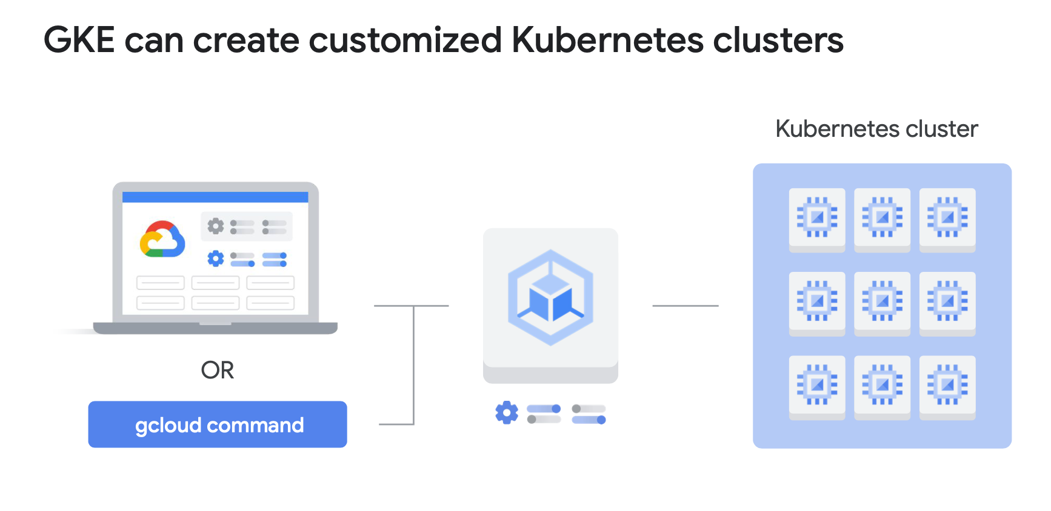
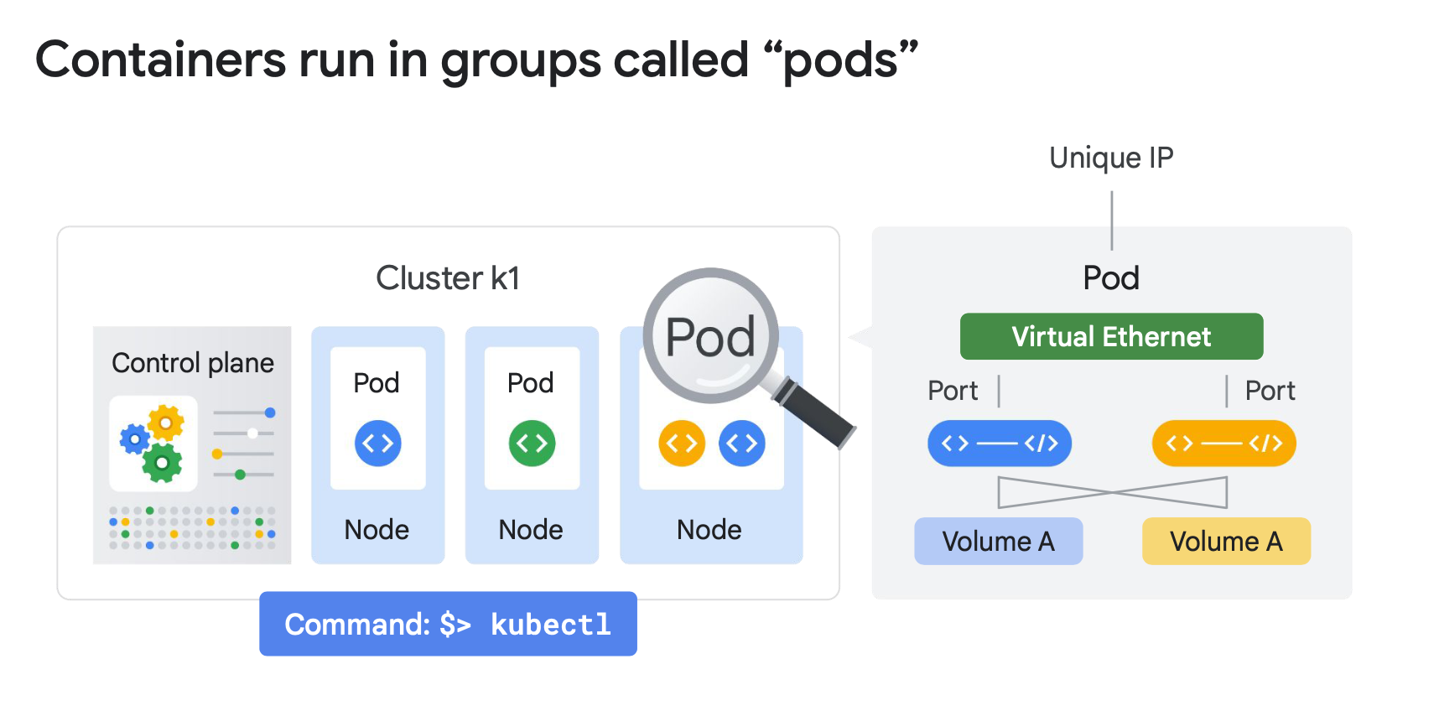
kubernetes

Slide 85
GOOGLE CLOUD RUN
Cloud Run is a managed platform for running stateless containers via web requests or Pub/Sub events.
It is Serverless, eliminating infrastructure management tasks and allowing developers to focus solely on application development.
Cloud Run scales rapidly, adjusting resources based on demand and billing only for actual usage.
The developer workflow involves writing the application, packaging it into a container image, and deploying it to Artifact Registry for deployment on Cloud Run.
Images must be stored in Artifact Registry for deployment.
Developers can deploy code from local sources or existing images in Artifact Registry.
After deployment, Cloud Run provides a unique HTTPS URL to access the application.
It dynamically manages containers to efficiently handle incoming requests.
The Serverless nature of Cloud Run allows developers to focus on coding without the need for infrastructure maintenance.

Slide 86
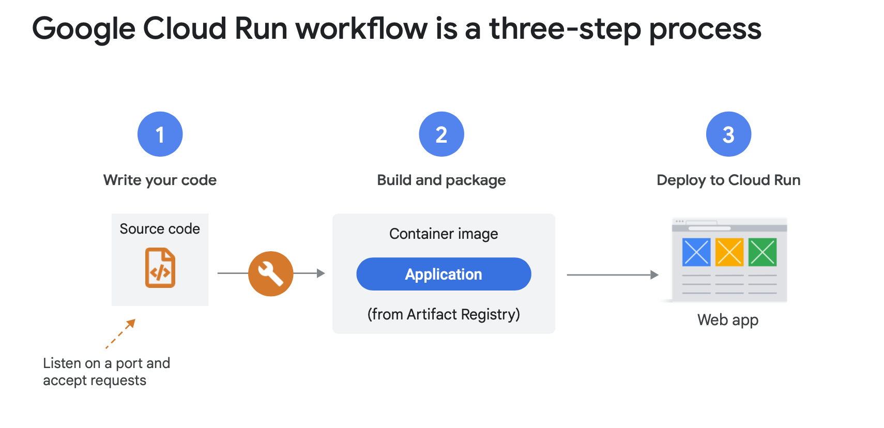
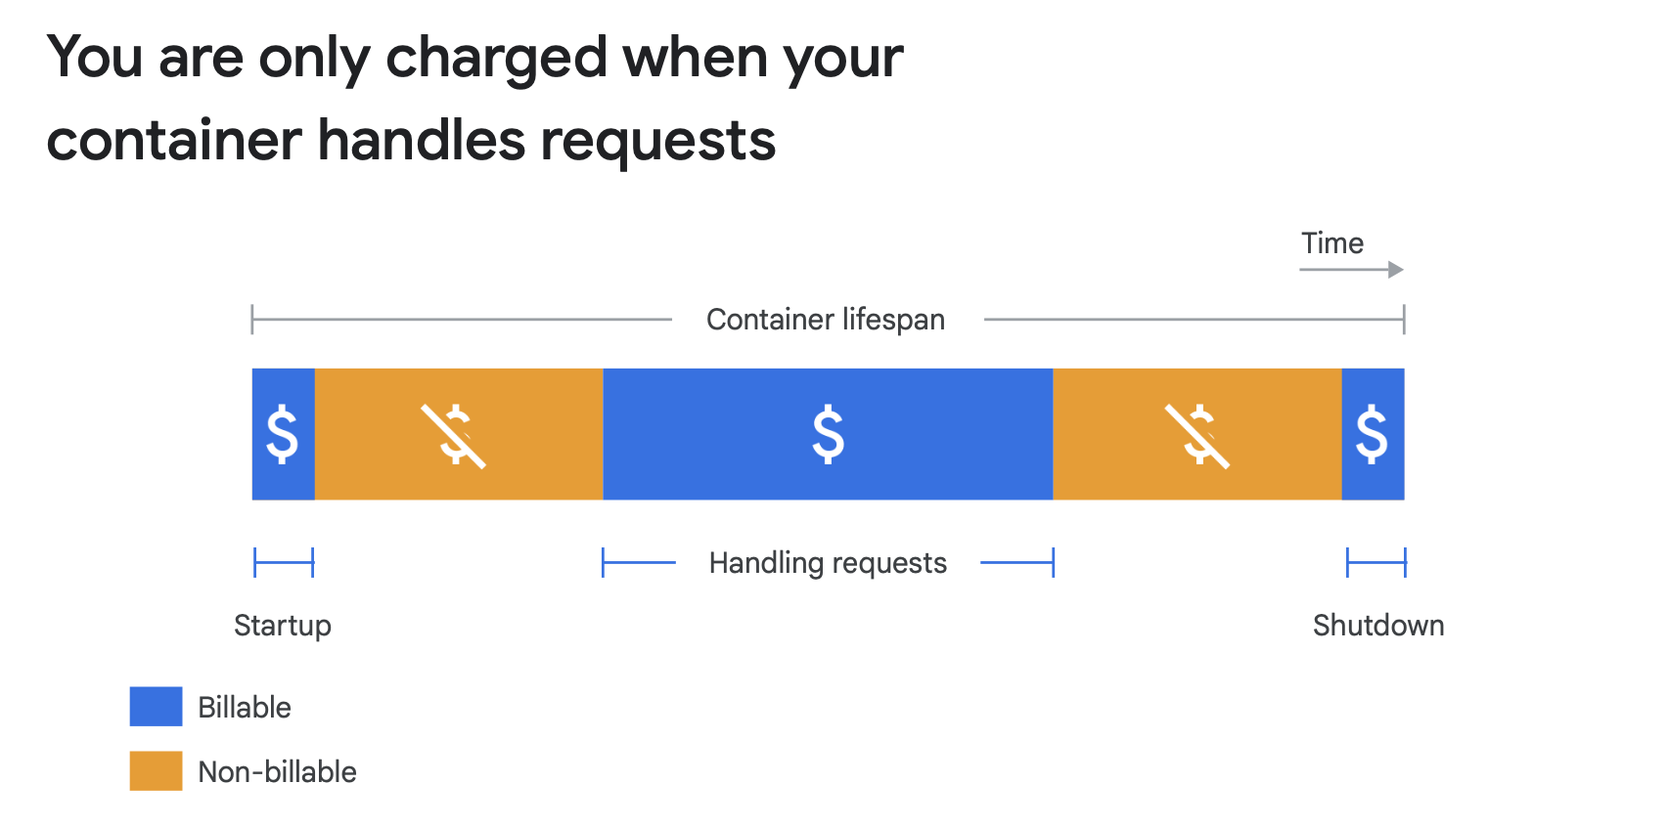
GOOGLE CLOUD RUN

Slide 87
GOOGLE CLOUD RUN quiz
Cloud Run can only pull images from:
A: Docker Hub
B: Self-hosted registries
C: Artifact Registry
D: GitHub

Slide 88
CLOUD FUNCTIONS
Cloud Functions allows for creating simple and specific functions that automatically execute in response to cloud events, such as the uploading of a new image, the deposit of a file in Google Cloud Storage, etc.
It is a lightweight, event-based, and asynchronous computing solution that does not require server management or runtime environment.
These functions can be used to build applications from small business logics and to connect and extend cloud services.
Billing occurs at the closest to the millisecond, only during code execution, allowing for economical use of resources.
Cloud Functions supports multiple programming languages, providing flexibility to developers.
Events from Cloud Storage and Pub/Sub can trigger functions asynchronously, while HTTP invocation allows for synchronous execution for direct interactions with the API.

Slide 89
CLOUD FUNCTIONS quiz
What is the advantage of putting the event-driven components of your application into Cloud Functions?
A: Cloud Functions means that processing always happens free of charge.
Not free of charge !
B: Cloud Functions handles scaling these components seamlessly.
Correct! Your code executes whenever an event triggers it, no matter whether it happens rarely or many times per second. That means you don't have to provision compute resources to handle these operations.
C: Cloud Functions can be written in C# or C++
Cloud Functions are written in Javascript (Node.js), Python, or Go.
D: Cloud Functions eliminates the need to use a separate service to trigger application events.

Slide 90
GOOGLE CLOUD DATAFLOW
DataFlow is a real-time and batch data processing solution offered by Google Cloud Platform (GCP). It is based on Apache Beam, a unified programming model for parallel and distributed data processing.
DataFlow operates by allowing developers to define data pipelines using the Apache Beam API. These pipelines describe data processing, whether it involves reading data from a source, transforming it, and writing it to another destination.
There are numerous advantages to DataFlow. Firstly, it offers automatic scalability, efficiently processing massive volumes of data, whether in real-time or batch. Additionally, it integrates well with other GCP services such as Pub/Sub and BigQuery, making it easy to build comprehensive data pipelines. Furthermore, DataFlow is fully managed, meaning Google handles infrastructure maintenance, allowing developers to focus on application development.
However, there are some drawbacks. Pricing can become complex as pipelines become more intricate and data volumes increase. Additionally, although DataFlow is extremely powerful, its learning curve can be steep for new users, especially if they are not familiar with Apache Beam.

Slide 91
GOOGLE CLOUD pub-sub
Pub/Sub, or Publisher/Subscriber, is a fully managed event messaging service offered by Google Cloud Platform. It allows applications to communicate with each other asynchronously, ensuring high scalability and robust reliability.
The operation of Pub/Sub is simple: applications send messages to topics, and then the messages are received by subscribers who are interested in those topics.
There are numerous advantages to Pub/Sub. Firstly, it offers automatic scaling, efficiently processing millions of messages per second. Additionally, it ensures reliable message delivery, even in the event of a system component failure. Pub/Sub also seamlessly integrates with other GCP services, making it easy to build cloud-native applications.
However, there are a few disadvantages to consider. Pub/Sub pricing can increase rapidly with the volume of messages processed, and it can be challenging to predict exact costs.

Slide 92
GOOGLE CLOUD dataproc
Cloud Dataproc is a fully managed data processing service based on Apache Hadoop and Apache Spark, offered by Google Cloud Platform (GCP). It allows users to quickly deploy compute clusters in the cloud for analyzing, processing, and transforming large datasets.
The operation of Cloud Dataproc relies on dynamically creating compute clusters, which can be scaled based on data processing needs. Users can run batch processing tasks, interactive analyses, and even streaming workflows.
The advantages of Cloud Dataproc are significant. Firstly, it offers elastic scalability, allowing users to provision and deactivate clusters quickly based on workload. Additionally, Cloud Dataproc is compatible with open-source data processing tools and frameworks such as Apache Spark, Apache Hadoop, and Presto, providing great flexibility to users. Furthermore, Cloud Dataproc seamlessly integrates with other GCP services like BigQuery and Google Cloud Storage, making it easy to build comprehensive data pipelines.
However, there are a few drawbacks. Cloud Dataproc pricing can be complex, as it depends on the type of instance used, the cluster's runtime duration, and other factors. Additionally, while Cloud Dataproc offers great flexibility, cluster management and configuration can be complex for less experienced users.

Slide 93
AI SERVICES ON GCP

Slide 94
GOOGLE CLOUD vertex-ai
Vertex AI is a fully managed artificial intelligence (AI) platform offered by Google Cloud Platform. It allows developers and data scientists to easily create, deploy, and manage AI models at scale.
The operation of Vertex AI is based on a modular approach, offering tools for every stage of the AI model lifecycle. This includes data preparation, model training, model deployment in production, and monitoring their performance.
There are numerous advantages to Vertex AI. Firstly, it offers a unified experience for AI model development and deployment, reducing complexity and required efforts. Additionally, Vertex AI provides advanced features such as AutoML (automated machine learning) and TensorFlow Enterprise, enabling users to create AI models even without deep expertise in data science. Furthermore, Vertex AI seamlessly integrates with other GCP services, making it easy to build comprehensive AI pipelines.
However, there are a few drawbacks. Vertex AI pricing can become complex, depending on the resources used and the size of deployed models. Additionally, while Vertex AI offers many features, some advanced tasks may require additional expertise in data science or software engineering.

Slide 95
GOOGLE CLOUD vertex-ai
Vertex AI is a machine learning (ML) platform that allows you to train and deploy ML models and AI applications, and customize large language models (LLMs) for use in your AI-based applications. Vertex AI combines data engineering, data science, and ML engineering workflows, enabling your teams to collaborate using a common set of tools and scale your applications by leveraging the benefits of Google Cloud.
Vertex AI offers several options for model training and deployment:
AutoML allows you to train tabular, image, text, and video data without writing code or preparing data splits. Just choose your dataset and the target variable to predict.
Custom training gives you full control over the training process, including using your preferred ML framework, writing your own training code, and choosing hyperparameter tuning options.
Model garden enables you to discover, test, customize, and deploy models in Vertex AI, and select from Open Source Software (OSS) models and components.
Generative AI allows you to access large generative AI models from Google (and others) for multiple modalities (text, code, images, voice). You can fine-tune Google's LLMs to meet your needs, and then deploy them for use in your AI-based applications.
Additionally, predictive models can be created in BigQuery using BQML. These models can be used in Vertex AI.

Slide 96
GOOGLE CLOUD vertex-ai
Once your models are deployed, use Vertex AI's end-to-end MLOps tools to automate and scale projects throughout the ML lifecycle. These MLOps tools run on fully managed infrastructure that you can customize based on your performance and budget needs.
You can use the Vertex AI Python SDK to run the entire machine learning workflow in Vertex AI Workbench, a development environment based on a Jupyter notebook. You can collaborate with a team to develop your model in Colab Enterprise, a version of Colaboratory integrated with Vertex AI. Other available interfaces include the Google Cloud console, the gcloud command-line tool, client libraries, and Terraform (limited compatibility).
Vertex AI also offers the ability to label data in your datasets.
Pre-trained models are available via API: Google Vision API, Google Speech API, etc., with a cost per call.

Slide 97
GOOGLE CLOUD vertex-ai mlops
Once your models are deployed, they need to track changes in the environment to optimize their performance and remain relevant. MLOps is a set of practices that improves the stability and reliability of your ML systems.
Orchestrating workflows: Manually training and deploying your models can be time-consuming and error-prone, especially if you need to repeat processes multiple times. Vertex AI Pipelines allow you to automate, monitor, and manage your ML workflows.
Tracking metadata used in your ML system: In data science, it's important to track the parameters, artifacts, and metrics used in your ML workflow, especially when you're repeating the workflow multiple times. Vertex ML Metadata allows you to query this metadata to analyze, debug, and audit the performance of your ML system or the artifacts it produces.
Identifying the best model for a use case: When trying new algorithms, you need to know which trained model performs best. Vertex AI tests allow you to track and analyze different model architectures, hyperparameters, and training environments to identify the best model for your use case.
Vertex AI TensorBoard allows you to track, visualize, and compare ML experiments to measure the performance of your models.

Slide 98
GOOGLE CLOUD vertex-ai mlops
Managing model versions:
Adding models to a central repository allows you to track model versions. Vertex AI Model Registry provides an overview of your models to better organize, track, and train new versions. From Model Registry, you can evaluate and deploy models to an endpoint, create batch predictions, and view information about specific models and model versions.
Managing features:
When reusing ML features across multiple teams, you need a fast and efficient way to share and distribute them. Vertex AI Feature Store provides a centralized repository for organizing, storing, and publishing ML features. By using a central feature store, your organization can reuse ML features at scale and accelerate the development and deployment of new ML applications.
Monitoring model quality:
A model deployed in production performs best on prediction input data similar to the training data. When input data deviates from the data used to train the model, model performance can degrade, even if the model itself hasn't changed. Vertex AI Model Monitoring monitors training/inference gaps and prediction drifts, sending alerts when prediction input data is too far from the training reference. You can use alerts and feature distributions to determine if you need to retrain your model.

Slide 99
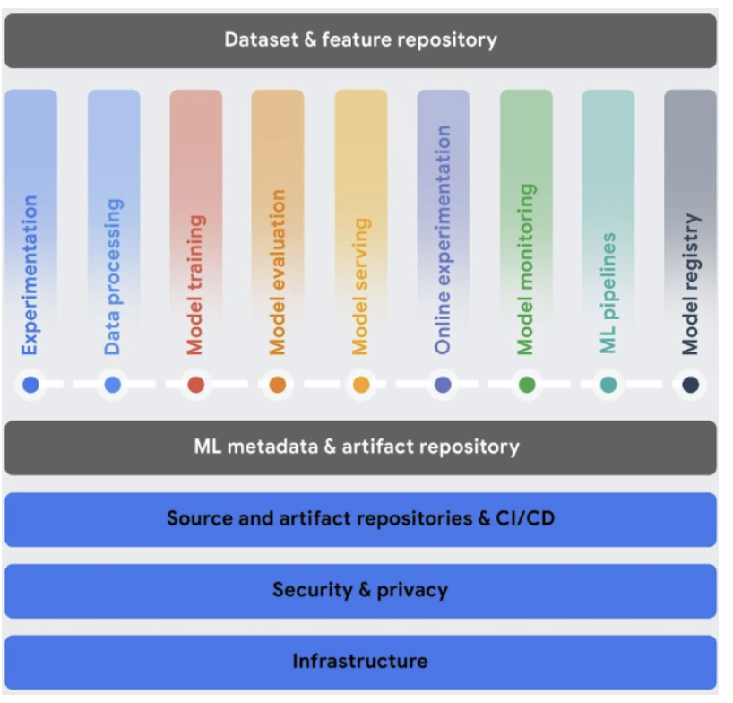
GOOGLE CLOUD vertex-ai mlops

Slide 100
GOOGLE CLOUD vertex-ai gen ai
Generative AI on Vertex AI gives you access to large generative AI models from Google so you can test, customize, and deploy them for use in your AI-enhanced applications.
Here is a description of the generative AI workflow:
The Prompt: The generative AI workflow typically starts with a prompt. A prompt is a natural language request sent to a language model to trigger a response. Writing a prompt to get the desired response from the model is a practice called prompt engineering. Although designing a prompt is an experimental process, you can use principles and prompt design strategies to prompt the model to behave as desired.
Base Models: Prompts are sent to a model for response generation. Vertex AI has various foundational generative AI models accessible via an API, including the following:
Gemini API: Advanced reasoning, multi-turn chat, code generation, and multimodal prompts.
PaLM API: Natural language tasks, continuous vector representations of text, and multi-turn chat.
Codey API: Code generation, code completion, and code chat.
Imagen API: Image generation, image editing, and image description.
MedLM: Medical question-answering and synthesis system. (Private Beta)
The size, modality, and costs of models vary. You can explore Google's proprietary models and OSS models in the Model Garden.

Slide 101
GOOGLE CLOUD vertex-ai gen ai
You can customize the default behavior of Google's base models so they consistently generate desired results without using complex prompts. This customization process is called Fine Tuning. Customizing these models helps reduce the cost and latency of your requests by allowing you to simplify your prompts.
Vertex AI also provides model evaluation tools to help you assess the performance of your fine-tuned model. Once your fine-tuned model is ready for production, you can deploy it to an endpoint and monitor its performance, as in standard MLOps workflows.
If the prompt and response pass security filter checks, the response is returned. Typically, the response is returned all at once. However, you can also receive responses progressively as they are generated by enabling streaming.
Another method for customizing a generative AI is called Retrieval augmented Generation (RAG):
Can be used to create applications outside of GCP.
Can be used within the 'Gen App Builder,' which is a GCP application.

Slide 102
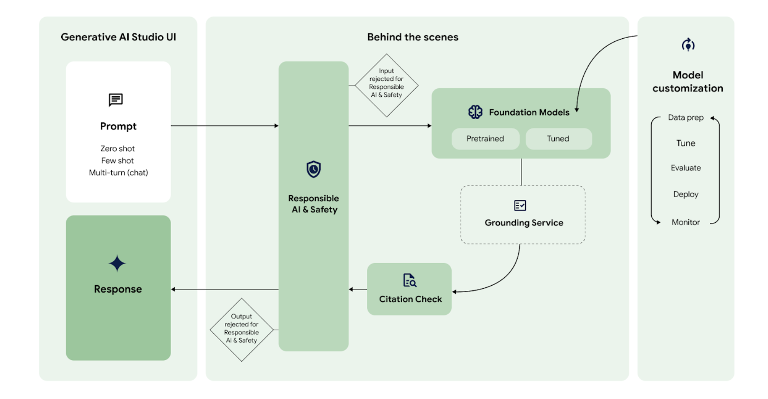
GOOGLE CLOUD vertex-ai gen ai

Slide 103
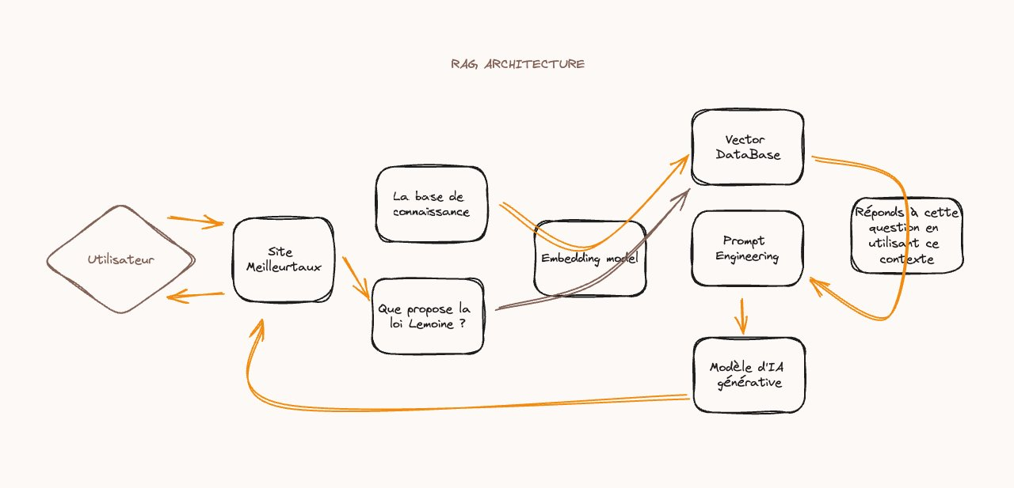
GOOGLE CLOUD vertex-ai gen ai

Slide 104
Thank you!

